Slide 1
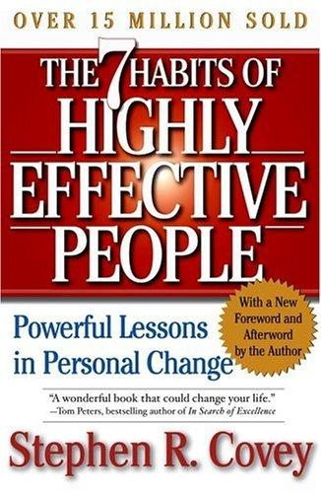
“7 HABITS OF HIGHLY EEFECTIVE PEOPLE”
Habit 3 : Put First thing first
PRESENTED BY : Naveen Jain
BY : STEPHEN COVEY

Slide 2
Table of Contents
31/03/25
Put First Things First
Actions Related to Prioritizing
Willpower/Won’t-power
Packing More Into Your Life
The Time Quadrants (and description)
Pick Up a Planner
The “Rock” Story / Plan Weekly / Adapt Daily
The Other Half
Comfort Zone/Courage Zone / Overcoming yourself
The Common Ingredient of Success

Slide 3

Putting first things first is organizing and executing around mental creation (your purpose, vision, values, and most important priorities.) The main thing is to keep the main thing the main thing.

Slide 4



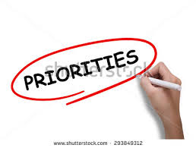


WHAT HABIT # 03 “PUT FIRST THING FIRST” ACTAULLY SAYS…………?

Slide 5

Actions Related to Prioritizing
Time management is about:
learning to prioritize and manage your time so that your first things come first and not last

Slide 6




Habit # 03 based on the principle of time management
Time management is the act or process of planning and exercising conscious control over the amount of time spent on specific activities, especially to increase effectiveness, efficiency or productivity

Slide 7


IMPORTANCE OF TIME
-Represents our directions , missions , visions, goals, roles , relations , principles
-What we feel is important & how we live / lead our lives
-Represents our schedules , dates , appointments ,commitments activities .
-What we actually do & how we manage our time

Slide 8
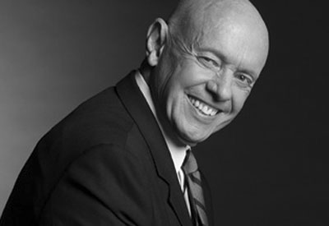
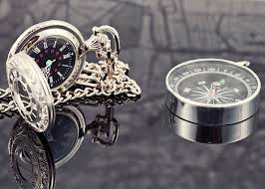
HABIT # 03 : AUHTOR’S QOUTATION
“BE GOVERNED YOURSELF BY YOUR COMPASS , NOT ONLY BY SOME CLOCK ON THE WALL”
BY: STEPHEN COVEY
Focus and keep your first thing first not only by considering the time which is symbolized by the clock but also by considering your roles, principles, and priorities which are symbolized by the compass

Slide 9



HABIT # 3 BASED ON 2 MAJOR COMPONENTS
Important
Your missions,
your goals,
Your roles
To decide your directions.

Slide 10

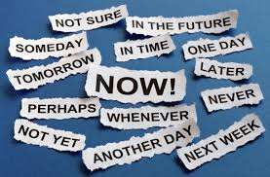
Habit # 03 Cont.….
Urgent
Pressing things upon you, things which give you a sense of urgency, you must act upon it
It requires immediate attention
Comes from environment

Slide 11
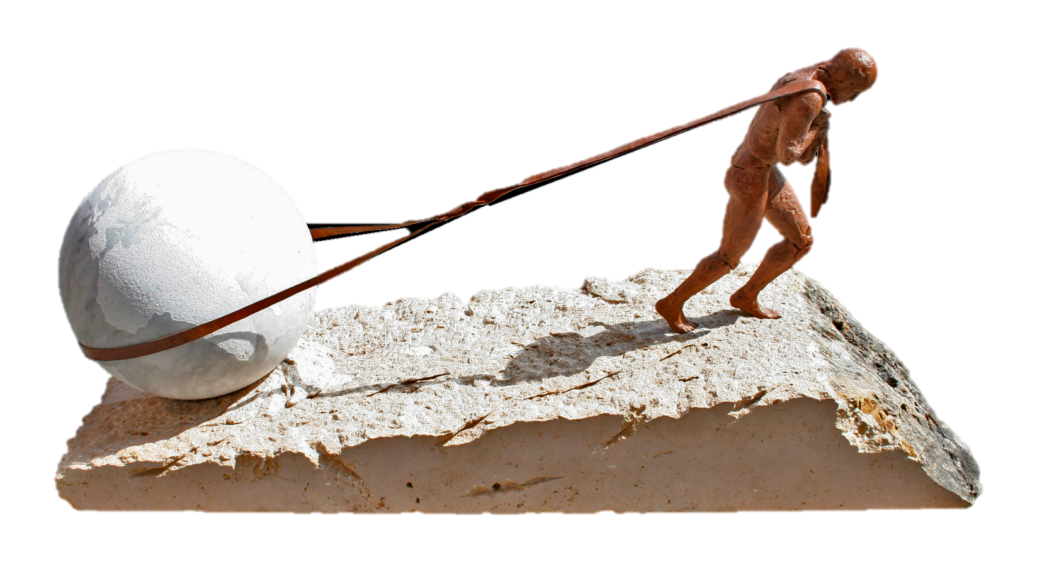
Willpower/Won’t-power
Willpower: say YES to your most important things
Won’t-power: say NO to less important things and peer pressure

Slide 12
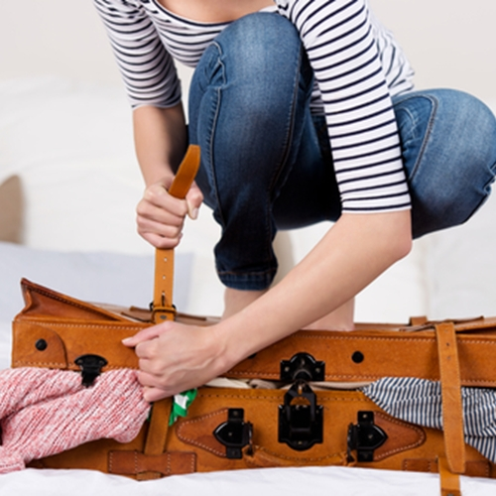

The better you organize yourself, the more you’ll be able to pack in more time for family and friends, more time for school, more time for yourself, and more time for your first things.

Slide 13
The Time Quadrants
The Time Quadrants model can help you prioritize your time into 2 main categories: Important and Urgent.
IMPORTANT:
Activities that contribute to your mission and goal.
URGENT:
Activities that demand immediate attention.

Slide 14
Time Management Matrix
Urgent
Non-Urgent
Important
Q1
Urgent & Important
(Problems, crisis, important meeting with urgent agenda)
Q2
Not Urgent & Important
(it attach your mission and goals but there is no urgency)
Not important
Q3
Urgent & Not Important
(its pressing, its that ringing phone , un answered mail, may be they are urgent but not connecting with your mission & goals, important to other people)
Q4
Not Urgent & Not Important
(time wasting activities, excessive TV, unnecessary meeting )

Slide 15

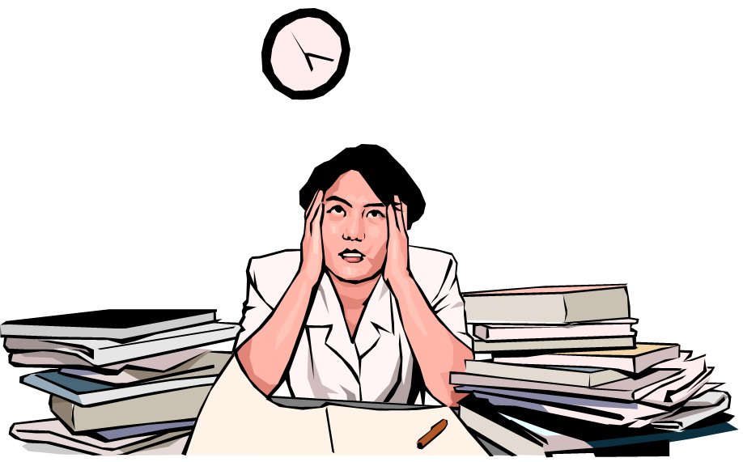

Quadrant 1: The Procrastinator Major block of Habit # 3
Procrastination is a challenge we have all faced at one point or another.
Planning is out of the question for the Procrastinator
Leads to stress:
Anxiety
Stress

Slide 16
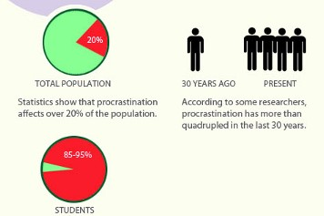
Procrastinator’s Statistics

Slide 17
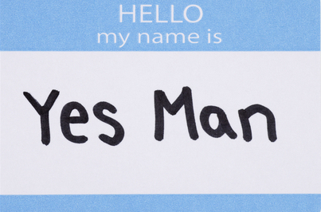



Quadrant 3: The Yes-Man
This quadrant is characterized by trying to please other people and responding to their every desire.
Not important for you but to the other people.
Results:
1) Reputation for being a "pleaser"
2) Lack of discipline
3) Feeling like a doormat for others to wipe their feet on.

Slide 18

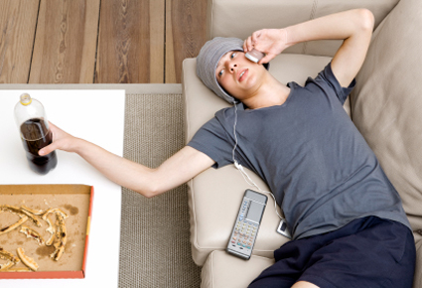

Quadrant 4: The Slacker
A Person who avoids work or duties
This is the quadrant of waste and excess.
This person loves anything in excess, like too much TV, sleep, or video games.
Nothing productive will get done if you spend time in this quadrant
The results of living in Q4 are:
1) Lack of responsibility
2) Guilt / កំហុស

Slide 19


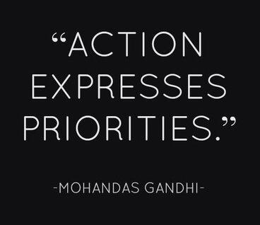
Quadrant 2: Prioritization
This is the quadrant of excellence -- the place you want to BE!
The person who Prioritize is clearly someone who takes time to plan.
The person who prioritize takes care of things they own such as their car making sure the oil is changed on time and that they have enough fuel in the tank.

Slide 20
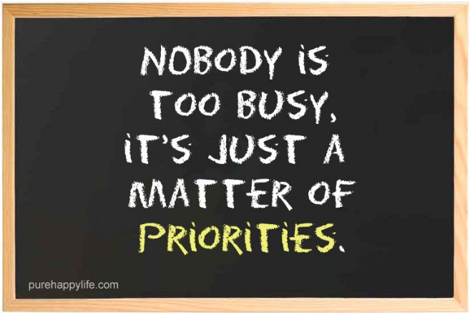

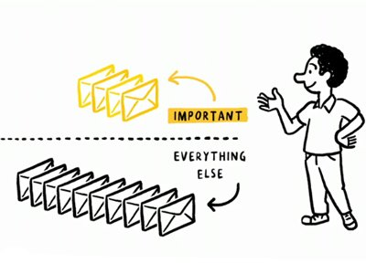

Prioritizes
Ranking
Friends and family come first for this person.
This person can say NO to things with a smile

Slide 21
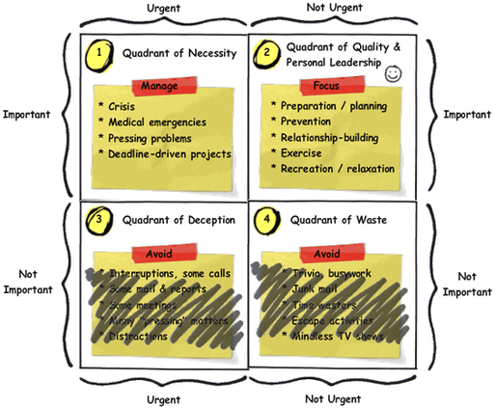
Focus on Quadrant 2

Slide 22
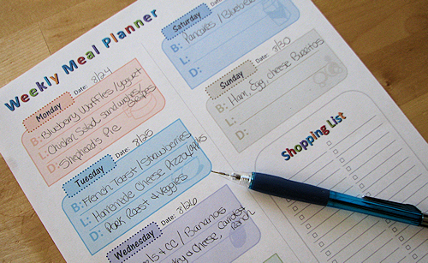

With a planner you’ll no longer have to worry about forgetting things or double-booking yourself.

Slide 23
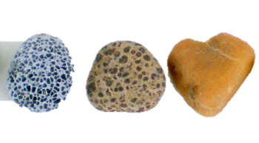
The “Rock” Story
A philosophy professor stood in front of his class and had some items before him. When the class began, he started demonstrating a life-related experiment. He poured rocks into a mayonnaise jar and asked the class if it was full. The class agreed it was. He then poured pebbles, and they eventually filled up the gaps between the rocks. The professor asked again whether the jar was full, and the class agreed once again that it was full. Finally, the professor poured sand into the jar, and the sand covered up all the remaining spaces.

Slide 24
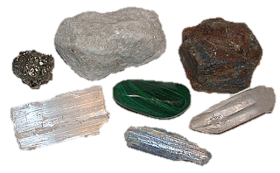
Continued
The professor’s purpose was for his students to realize the big rocks in their lives: the important things, such as family and health. The pebbles are the less important things such as money and car. The sand is everything else. The small stuff. If you put the sand or pebbles first, there is no room for the rocks.
In life, if you spend all the energy on the small stuff, you will never have time for truly important things. LEARN TO PRIORITIZE.

Slide 25

Plan Weekly
Step 1: Identify your big rocks
Think about what you want to accomplish in the upcoming week.
Step2: Block out time for your big rocks
Make schedules for big rocks
Step 3: Schedule everything else
- Make schedule for all the other small things.

Slide 26
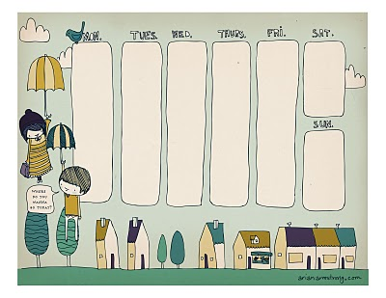
Adapt Daily
Make rearrangements of your important and less important things if necessary
If weekly planning is too rigid, make it lighter instead of giving up entirely
Eg. of Weekly schedule

Slide 27
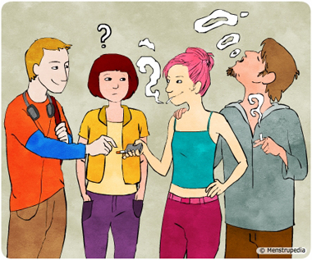

Time management is only half of Habit 3. The other half is learning to OVERCOME FEAR and PEER PRESSURE.

Slide 28

Comfort, Courage Zone
Comfort zone:
Things you are familiar with
Risk-free and easy
Courage zone:
Things that makes us feel uncomfortable
Filled with risks and challenges
A place for OPPORTUNITIES

Slide 29
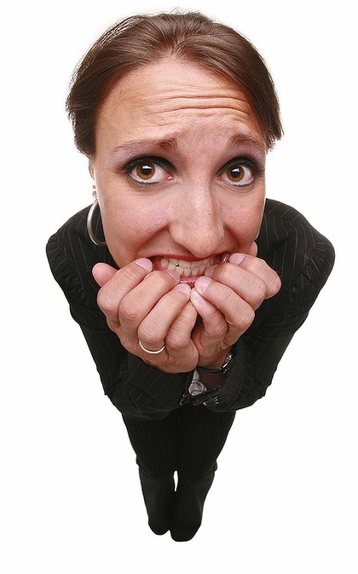
Overcoming Yourself
“It’s not the mountain we conquer, but ourselves.”
The risk of riskless living is the greatest risk of all.
Winning means rising each time you fall.
Don’t let your fears make your decisions.
Worry less about failing and more about chances you miss when you don’t even try.

Slide 30

(continued)
Be strong in the hard moments.
Standing up to bad peer pressure is a massive deposit into your Personal Bank Account.
Care less about what your peers think of you.
To stand against peer pressure, you must have self-confidence, self-respect, and a clear goal.

Slide 31
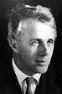
Be strong in hard moments
Two road diverged in a wood,
and I-
I took the one less traveled by,
And that has made all the
difference
Robert Frost

Slide 32
Real-Life Examples
Student: Prioritizing study and self-improvement over unnecessary social media use.
Professional: Scheduling deep work sessions rather than responding to every email instantly.
Entrepreneur: Focusing on business growth strategies rather than attending unproductive meetings.
Parent: Spending quality time with children instead of excessive screen time.

Slide 33

Ingredient for success
Putting first things first takes discipline.
Successful people do things they don’t necessarily want to, but they do them because they know it will lead them to their goals.
Willpower will help get things done whether you feel like it or not.
Value each moment, especially your adventurous teen years.

Slide 34

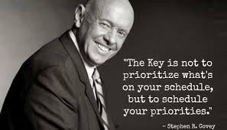

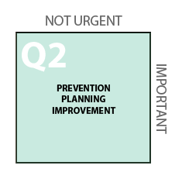


Summary(Moral)

Slide 35
